Slide 1
Cuckooing and criminality in the Private Rented Sector Julie Rugg, University of York

Slide 2
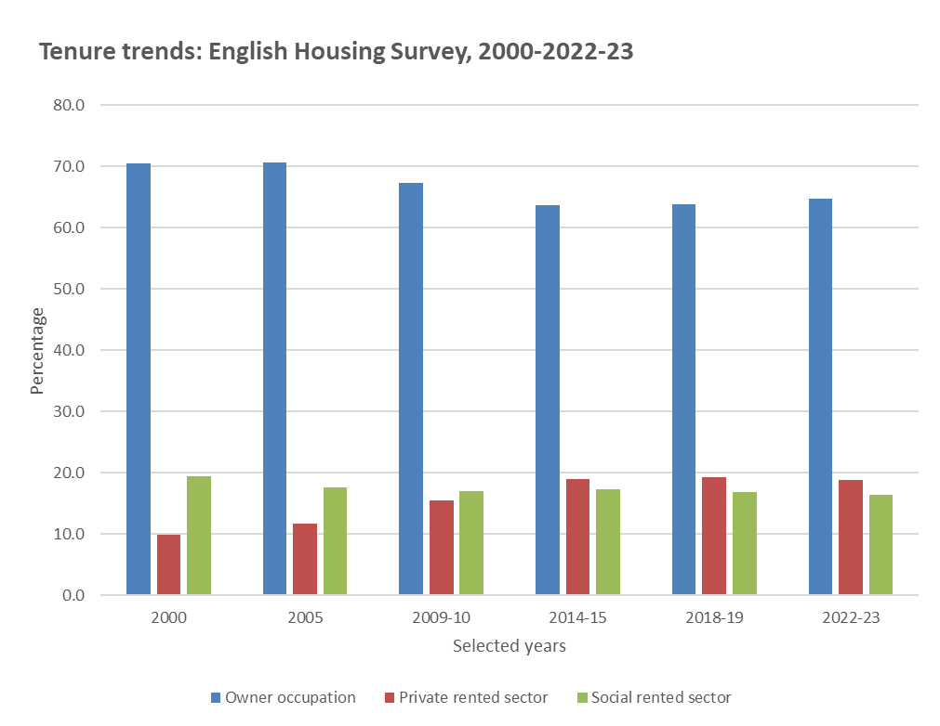
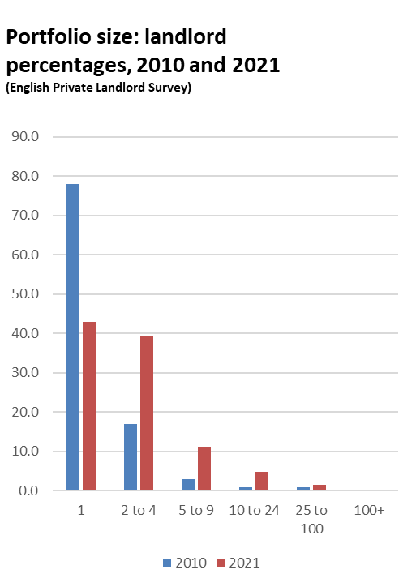

Slide 3
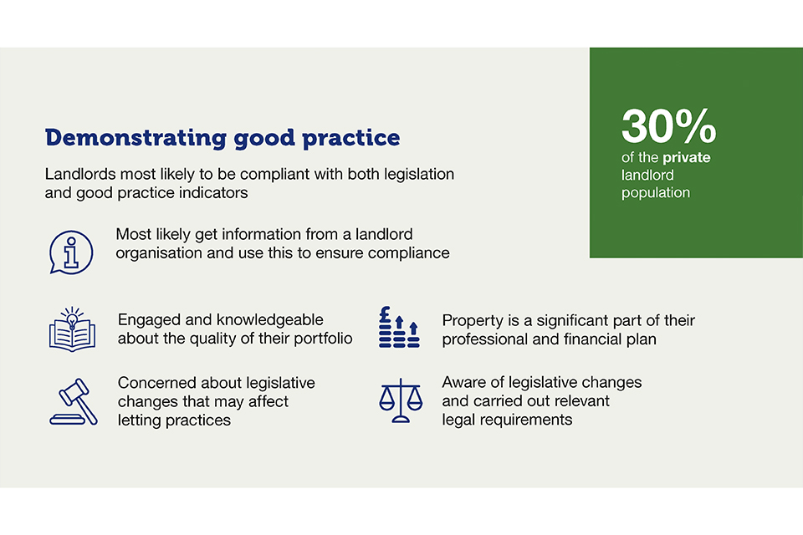
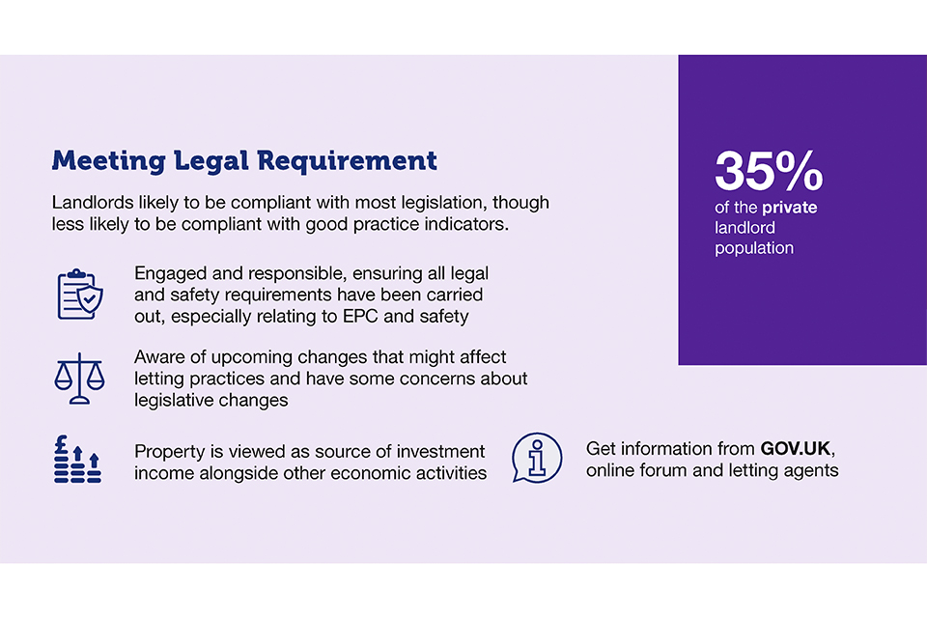
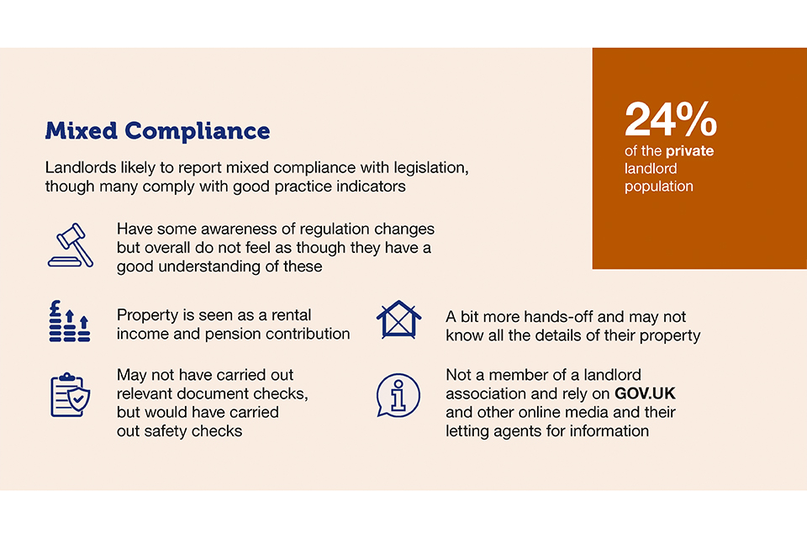
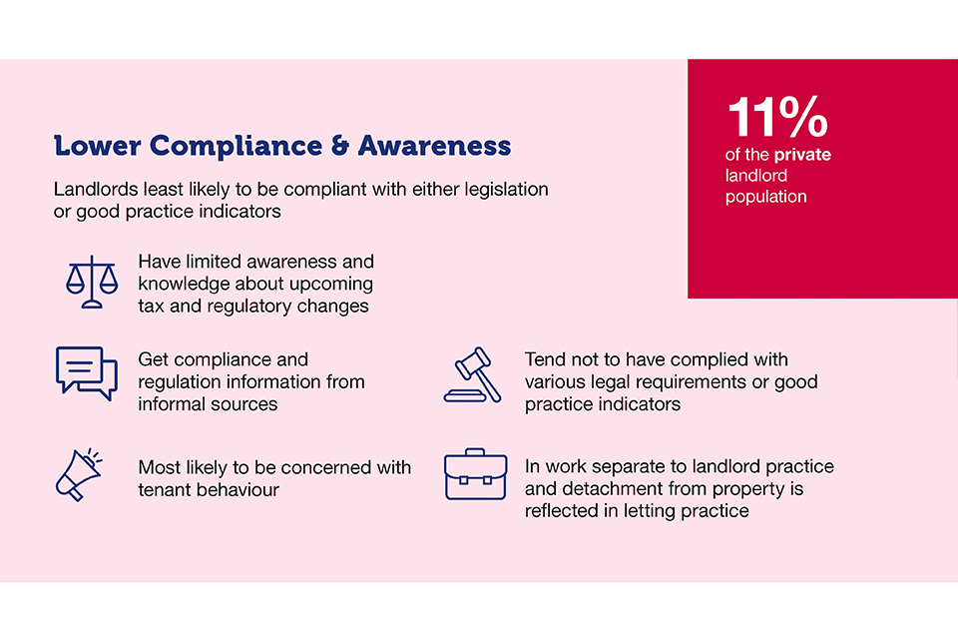

Slide 4
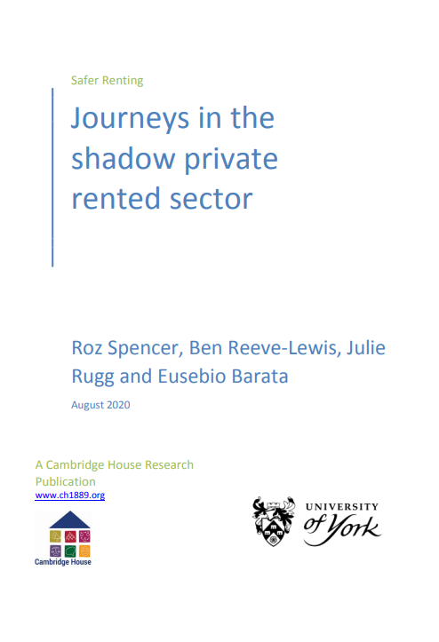
Wilfully ignorant landlords who tended to have small portfolios and were letting with no intention of meeting their statutory obligations
Corner cutters had larger portfolios and maximised their rental income through non-compliance, factoring penalties and fines into their business model
Prolific offenders showed a blatant disregard for the law, often acting unpleasantly and with impunity, and were confident about their ability to challenge any attempt at prosecution
Letting linked to organised crime in which letting might be associated with labour and sex trafficking, and the use of rented properties as cannabis farms

Slide 5
Understand criminal behaviour: We want to find out more about the criminal behaviours that are linked to letting property, and better understand why individuals become involved in this kind of activity (Xavier L’Hoiry, Loren Parton, Georgios Antonopoulos and Geoff Page).
Examine and learn from the most effective solutions: Many different agencies are involved in policing the private rented sector. We want to examine and learn from ways to tackle landlord crime and spread examples of best practice particularly when agencies work together (Julie Rugg).
Housing justice: How do local authorities decide to take legal action under their housing powers against criminal landlords? We want to explore how cases are prosecuted or not, and compare the decisions being made by magistrates and the First Tier Property Tribunal (Caroline Hunter and Kit Colliver).
Work with tenants: The study will work with tenants who have been subject to criminal landlord behaviour to better understand their experiences and the ways in which those experiences can inform local policing and regulatory interventions (Lisa O’Malley, Phil Marshall, Laith Sweiss and Daniella Lightowers)

Slide 6
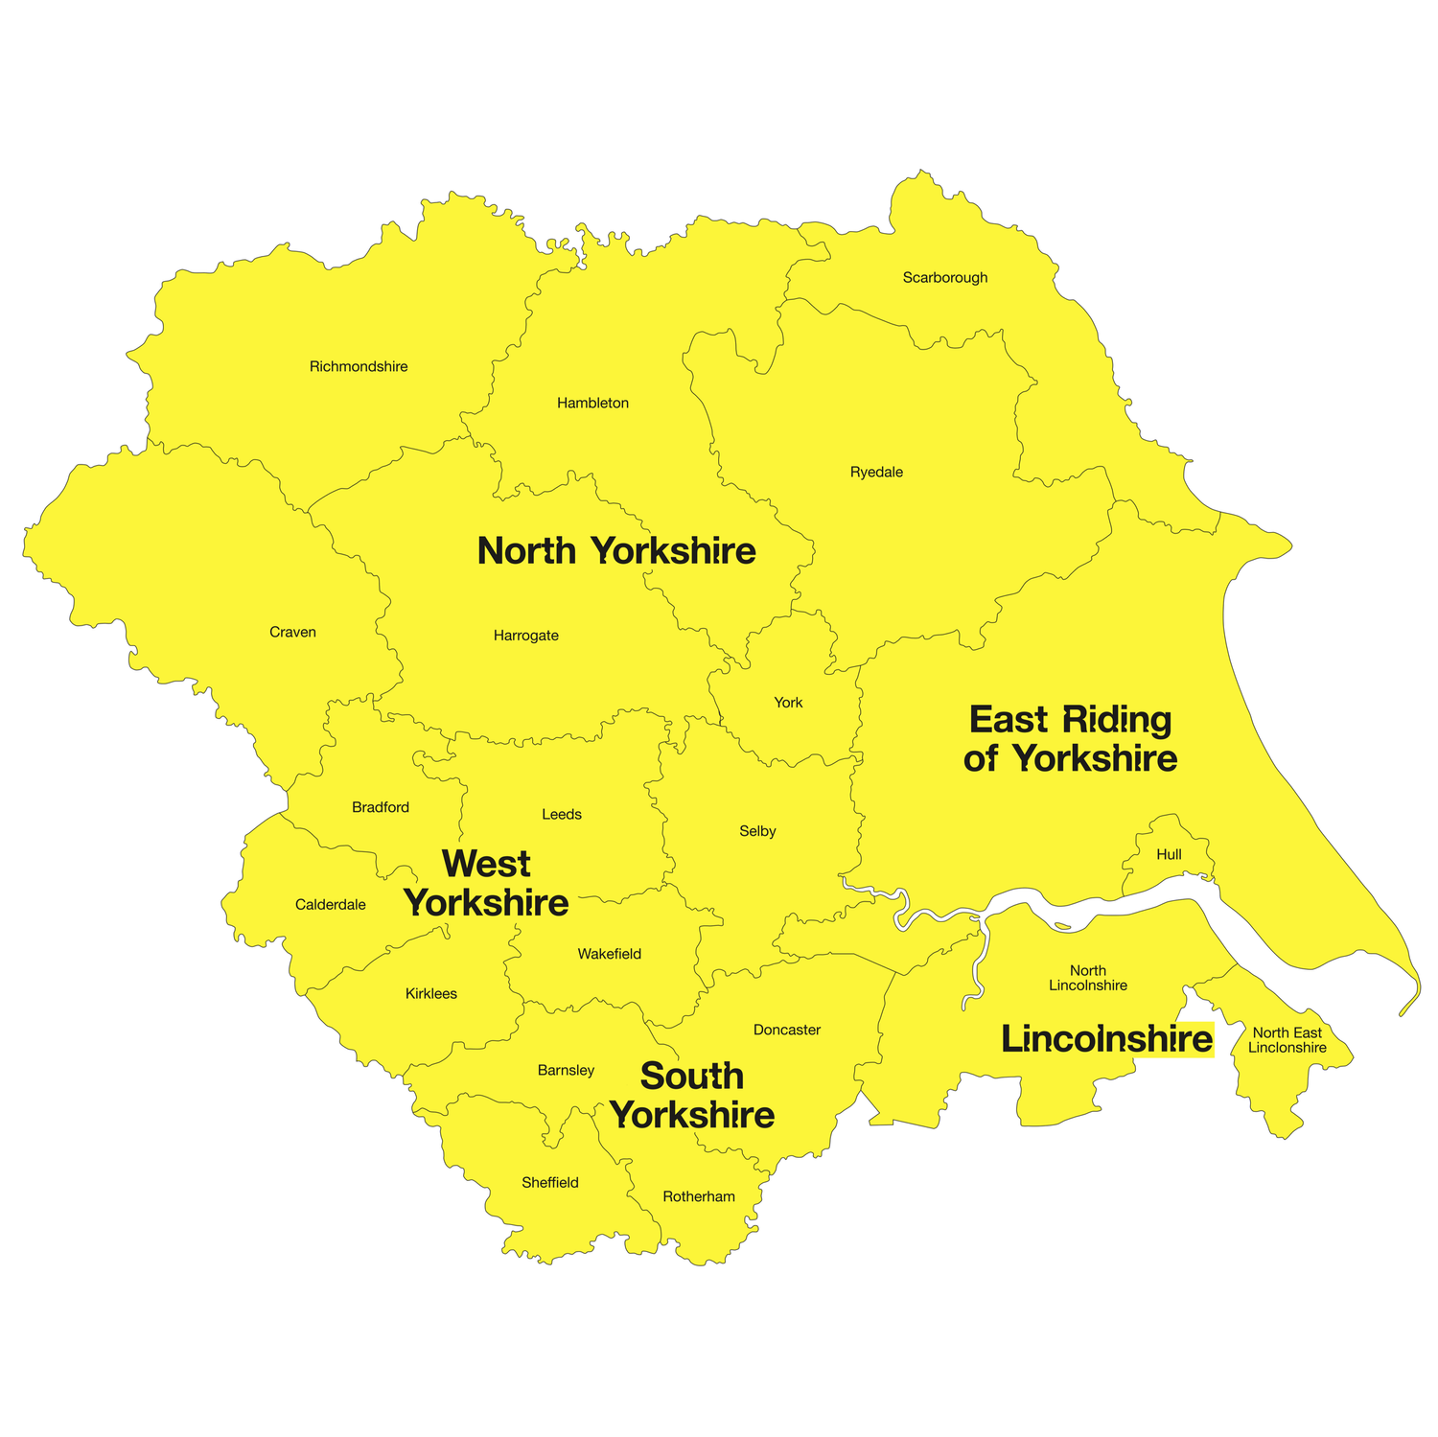
Yorkshire and the Humber Region - 0.5mn people - 15 local authorities and four separate police forces - Range of settlement types: declining coastal; post-industrial urban; large ex-council estates - Pockets of acute deprivation: contains 20 of the 100 most deprived LSOAs [lower super-output areas]; with low-value housing

Slide 7
Response to the question: is criminal landlordism a problem in your area?
For me, there’s almost two levels of criminal landlord really. There’s your criminal landlord that fails to comply with housing law, you know, that fails to comply with notices and you end up prosecuting for that offence, or civil penalties.
And there’s your landlord that runs HMOs that’s not licenced and that fails to comply with management regulations and so forth.
That’s one level, I think, of criminal landlord. But what we’re finding now, we’re finding landlords that are linked and involved with serious organised crime and I’m talking about your money laundering, human trafficking and modern-day slavery, but what we’re seeing more and more of, a lot of now in [AREA] is cannabis cultivation.

Slide 8
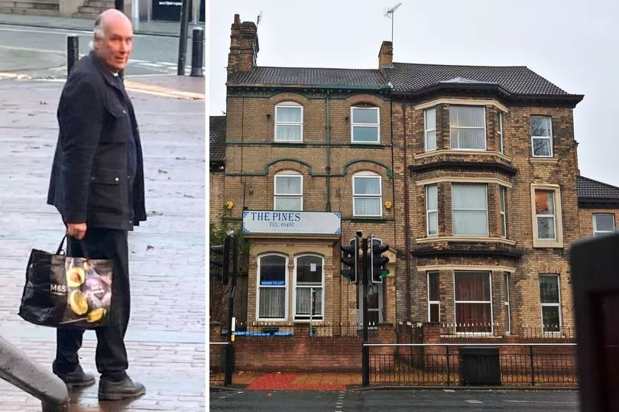
Hull landlord with ‘vast income’ and ‘70 properties’ gets 11 years for huge cannabis conspiracy
A wealthy property landlord who allowed an "Albanian organised crime group" to take over houses that he owned has been jailed for 11 years.
Jeremy Southgate, 63, used "ghost tenants" from his letting agency and other sophisticated measures in a cynical bid to cover up 17 cannabis factories at a range of houses. The huge growing operation produced large amounts of cannabis for commercial use, with an estimated street value of £8.7m.

Slide 9
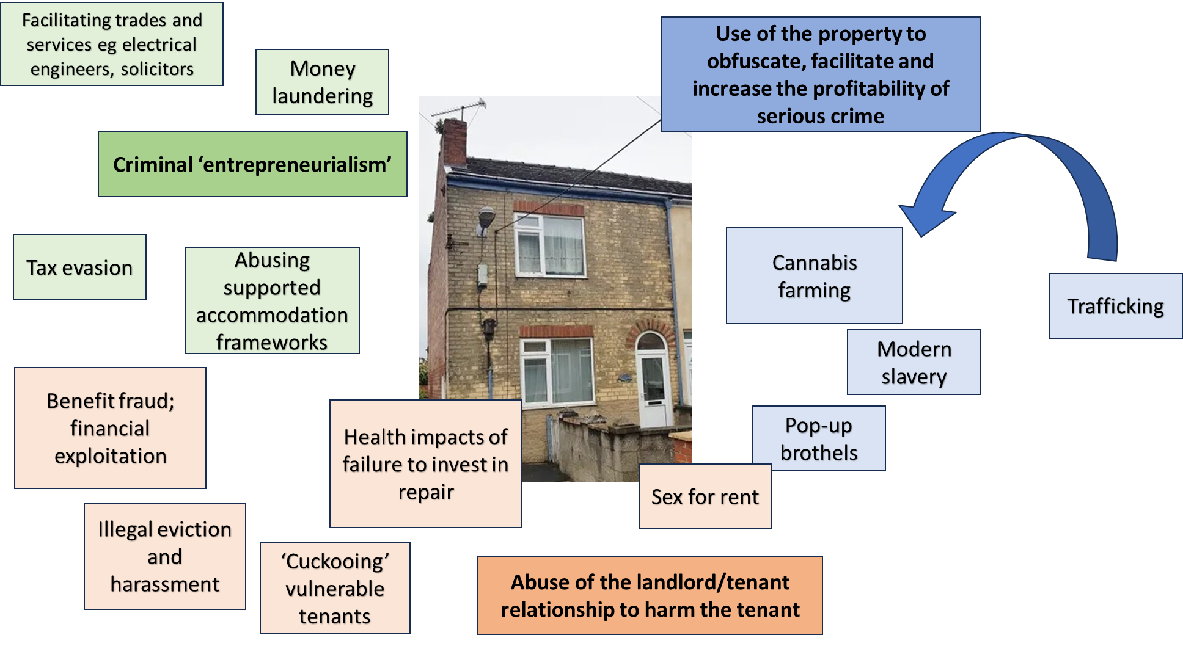

Slide 10
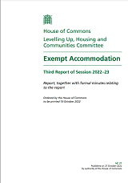
Exempt accommodation - Shared accommodation including support. In 2021, estimated 156,868 people living in exempt accommodation. - Aimed at individuals including people with extreme vulnerability to harm: care leavers, victims of domestic abuse, refugees, people with mental health problems, people with addictive behaviours, people released from prison - Accommodation and support often provided by a complicated arrangement between registered providers and landlords: there are multiple examples of poor practice including landlords and staff selling drugs, sexual exploitation and manipulation - Exempt accommodation in West Midlands is associated with serious crime

Slide 11
Households vulnerable to harm
Criminals/ landlords
Houses in multiple occupation
Private rented sector
(‘cottage industry’)
Exempt accommodation

Slide 12
Cuckooing in the private rented sector
Tenant is often vulnerable to harm as a consequence of mental health problems, age, isolation, economic marginality, migration status
Takes place within the victim’s home
Perpetrator is, essentially, trespassing or has secured entry coercively
Vicimization includes financial exploitation; theft of property; threat of physical violence; coercion into criminal activity; theft of property
Can be perpetrated by landlord or another tenant in the same property
A

