Slide 1
The Complexity of Cuckooing
Dr Craig Barlow
Criminologist and Independent Forensic Social Worker

Slide 2
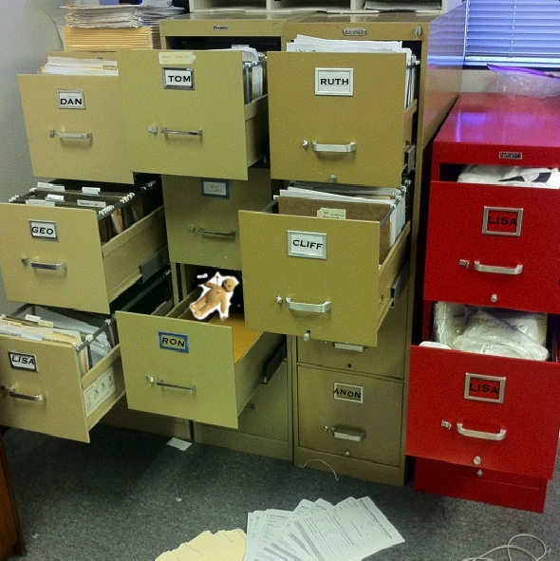
The Need for Theory
Our problem is not that we don't know much about exploitation of children and vulnerable adults in general, and criminal exploitation in particular... we are awash with data!
But we need to be able to understand it!
Theory enables us to understand and interpret that data, to make sense of it.

Slide 3
“Cuckooing” as an Emergent Pattern of Exploitation
Cuckooing is a term used to refer to a form of exploitation in which a person and their home is controlled through a parasitic relationship with a motivated perpetrator or group of perpetrators, with a view to the exploitation of the home and its occupant.
The Phenomenon has only received attention relatively recently and is discussed mostly in the in the context of criminal exploitation and county lines drugs distribution.
Patterns and contexts for such exploitation are however more varied and need to be understood as patterns of adaptive behaviours, transactions and events that are context specific and emerge over time.

Slide 4
A Complex Adaptive Systems Model of Cuckooing
The Circles of Analysis (Barlow 2019) proposes a complexity-based theory that explains how, and more importantly why, cuckooing emerges over time and in different contexts

Slide 5
A Complex System of Relationships
The Emergent Pattern of Abuse / Exploitation is determined by the characteristics of:
The Suitable Target
The Motivated Perpetrator(s)
The Conducive Environment

Slide 6
“The Possibility Space”
Target/Offender
Interaction
Suitable
Target
Value
Inertia
Visibility
Accessibility
Material Gain
Status
Emotional Outlet
Power assertion/reassurance
Motivated
Offender(s)
Conducive
Environment
Pattern of
Exploitation
“The Possibility Space”
Target / Environment
Interaction
“The Possibility
Space”
Offender(s) /
Environment
Interaction

Slide 7
Degrees of Organisation
1st Degree
2nd Degree
3rd Degree
Cuckooing Exploitation
Perpetrator moves
in as friend/partner
V.P. Befriended, individual and/or group visit frequently
Individual or Group moves in as a base for business
Perpetrator may stay for long period
Perpetrators control several properties
Use victim’s home to “hang out”, consumes food, alcohol, takes money etc.
Emotional/Psych coercion and control, creates dependency, increasingly isolates victim
May stay a few days and then return
May Force Tenant to move out for a period
May make some form of payment e.g. Exchange for drugs
Victim may be harassed, degraded and humiliated, physically abused and threatened
Property may
be watched
Property Used for Storage

Slide 8
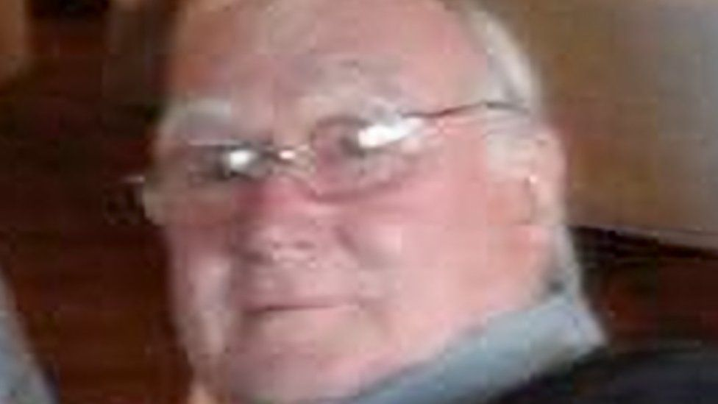
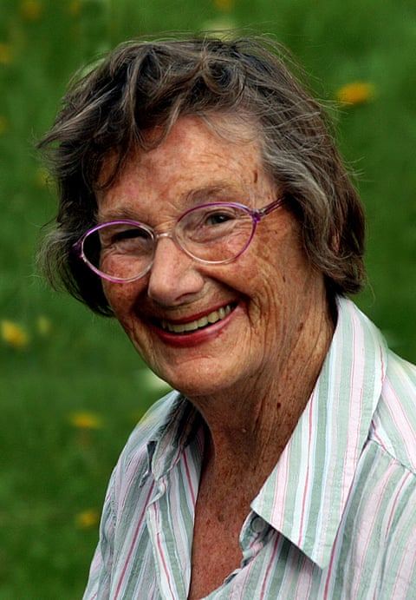
Examples - 1st Degree of Organisation
Joan Blass, 91
had severe dementia and terminal cancer. After her death in March 2016, her family discovered that a much younger man, age 68, had secretly married Joan five months previously.
She never knew that she was married
Barry Spooner, 74.
Mr Spooner had met Sara Hansford in 2020 and he took pity on her after she told him she was homeless.
From that point on she subjected him to ‘mental and physical suffering’, using a ‘combination of persuasion, threats, aggression and violence’ to cause him to give her his life savings to fund her drug habit

Slide 9
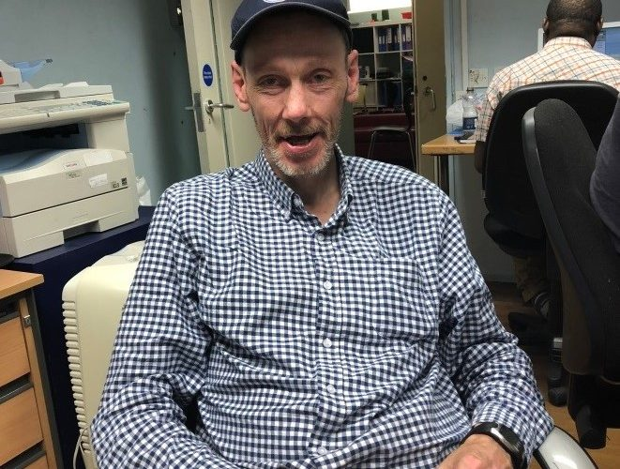
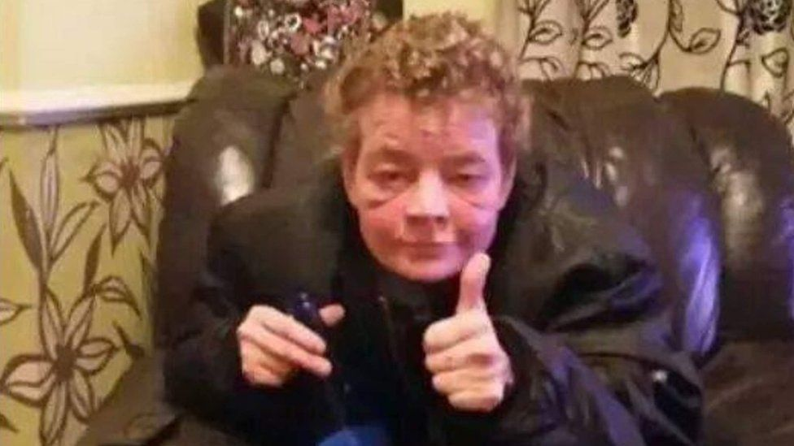
Examples: 2nd Degree of Cuckooing
Johnnie, who has a mild learning disability, invited someone who he thought was his friend into his house on a rainy afternoon. He thought the man would only stay for a couple of days.
By the time this ‘friend’ left four years later, he had stolen thousands of pounds and used Johnnie’s home to take and sell drugs.
Angela Wrightson, 47
Ms Wrightson would allow a steady stream of people into her home at all hours, day and night. Groups of youths started dropping by first thing in the morning so she could buy them cigarettes. Underage drinkers congregated in her living room and on the proviso she could share their drink, she would buy them alcohol from the local shop - where three-litre bottles of 7.5% cider can be bought for about £3.
Sometimes she called a neighbour "to make the kids scatter" when they ignored her pleas to leave.

Slide 10
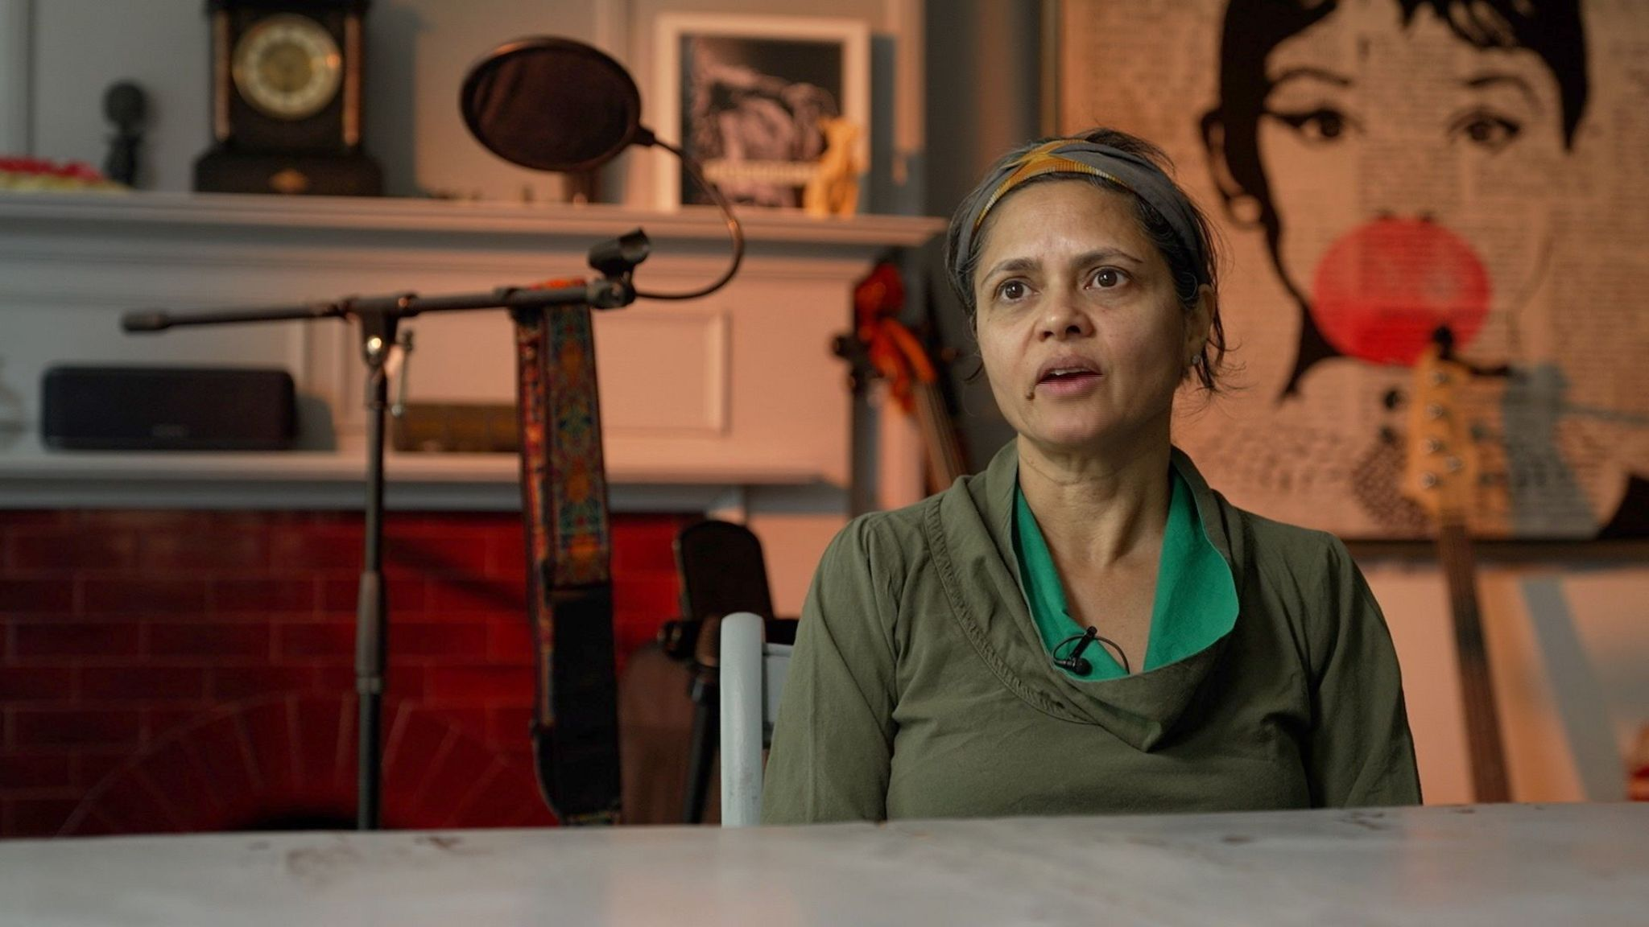
Examples: 3rd Degree of Organisation
Seema Rao-Reed also fell victim to criminals posing as legitimate tenants.
She had travelled to Dubai and decided to rent out her flat during her absence.
Ms Rao-Reed was approached by what appeared to be a reputable letting agent, who promised to find reliable tenants.
However, it turned out the agent was part of an elaborate scam targeting absent landlords.
Max, a former addict, was targeted by a group of dealers when his home in Wiltshire was taken over for two days.

Slide 11
Thank You
info@craigbarlow.co.uk

