Slide 1
The Role of a Housing Provider and the importance of effective partnership working when investigation Cuckooing
Cuckooing Research & Prevention Network Symposium
Wednesday 24th July 2024
Darren Burton (Partner – Green & Burton ASB Associates)

Slide 2
The value of a Registered Housing Provider when Cuckooing is identified or suspected
Local knowledge
Missing Persons (Young People)
Building trust
Providing homes to multiple generations of families
Knowing “what’s behind the door”
A commitment to sustaining tenancies whilst using endorsement action when it is proportionate to do so.
Engagement with the Third Sector / Charities
Specialist Teams

Slide 3
But….
Are we still as visible as we should be?
How effective is our communication with residents?
There was a 300% increase in Cuckooing cases across the London Boroughs between 2018-2022 – Could it have been more?

Slide 4
Reporting Cuckooing
How is Cuckooing recorded by organisations?
Is it a priority or a sub-category as part of a wider case investigation?
Can residents identify and understand the signs of Cuckooing (*sometime doesn’t look right) or do they just see it as ASB / Criminality?
Are there any barriers to information sharing?
How can we support the private rented sector in adjoining neighbourhoods?

Slide 5
….We hear this phrase a lot
“We don’t rehouse perpetrators; we address Anti-Social Behaviour!”
What are your thoughts?

Slide 6
If rehousing is deemed the best option….What’s the plan?
Does the victim want to move? – It’s his / her / their home after all!
Do we truly understand the needs of the victim?
Is this a properly managed move?
Are all the agencies involved that need to be and have we (as a partnership) delved deeper to identify any other forms of support?
Are there still potential gaps in the case management process?
Where is the property located and why was it chosen?
How is this giving the victim the best possible chance to move forward?
Are all internal departments pulling in the same direction?
Are we making use of “lived experience?”

Slide 7
A Consistent Approach
Neighbouring areas can be worlds apart
Not having to rely on personalities or individual contacts
Vulnerability Vs Safeguarding thresholds
The ability to escalate (and de-escalate) cases
If a threshold is not met….What are the alternatives?
Sharing best practice
Linking in with the Regional Organised Crime Units
Appropriate and safe disclosure of information to support victims and strengthen evidence gathering.

Slide 8
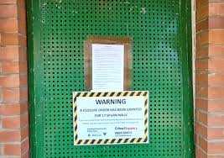
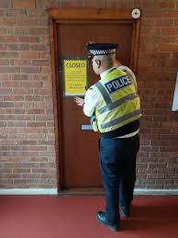
The Effective Use of Closure Orders
Who leads and is this clear?
Time critical – Window of opportunity
Sharing costs and resources
Giving consideration to partial closure orders
Will Registered Housing Providers be given delegated authority to use them?
Monitoring breaches
Only need to demonstrate that problems are coming from the property – Useful if you cannot identify the perpetrators.

Slide 9
Here’s a Case Study

Slide 10
Incentives for exploited young people who are part of a county line
A chance of new life
Escaping the control of an OCG
Building trust and having the confidence to give evidence
Are the alternatives worth the risk?
What role can a Housing Provider play (*despite a Housing crisis)?
Are we doing enough across the Social Housing Sector?

Slide 11
Thank you for listening
If you would like any further information on ASB, Cuckooing or any other issues, please contact me at darren@greenandburtonasb.co.uk

