Slide 1
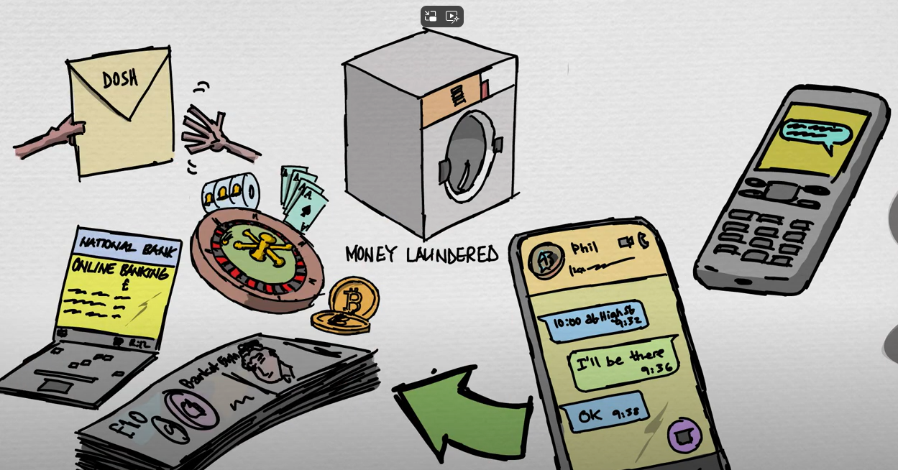
National County Lines
Co-ordination Centre
Notes:
As a co-ordination Centre, we tackle the use of vulnerability and exploitation in the drug supply chain.
The whole purpose of the county lines business model is for criminals to distance themselves from the supply of controlled drugs, but still profit from it.
The best way of achieving this is through the recruitment of others is to move, store and supply the drugs at street level and to move and launder the proceeds.

Slide 2
Cuckooing
Notes:
Cuckooing affords organised crime groups the ability to continue their criminality out of the public view. It’s a great way to store money, drugs and weapons and to accommodate people working on a county line.
Within the county lines business model, we come across a large number of individuals cuckooed by virtue of their drug use. What might start out as consensual use of their premises can quickly deteriorate and the relationship can turn sour with the individual no longer benefitting from the use of their home. Subsequently this can lead to a number of negative outcomes including violence.
Serious violence offences may take place in or near to cuckooed properties.

Slide 3
What are we doing as a programme?
Why Is Sec 45 Causing So Many Problems ?
Raising awareness through training
Working closely with partner agencies
Home Office funded task forces to target county lines and prosecute offenders
Recognising exploitation and using appropriate legislation to tackle it
Anti – Cuckooing initiatives
Notes:
The business model is constantly evolving in response to law enforcement tactics.
We recognize that cuckooing is an issue we can tackle more effectively. I was tasked earlier this year to review and improve the response to cuckooing nationally. Sadly, we are unable to say how prevalent the issue is because of a lack of recording and inconsistency in practice nationally. This is largely because cuckooing is not a crime that we can record. It may well be a factor in many different offences that we do record, but because of the way that data is collected, we can’t establish if this is the case or not.
So, to try and understand the prevalence of and the policing response to cuckooing, I have surveyed all police forces to capture current process and practice. I’m still reviewing this data, but I can mention a few of the findings:
Not all forces have any policy in place for responding to cuckooing.
There are pockets of good practice, but this is not always consistent across the whole force area.
The response to cuckooing tends to sit at neighbourhood policing level, with little to no governance over practice and process.
Many forces have asked for support to develop their response, policy and practice.
So, what have I done so far?
Liaised with academics in this field to better understand the problem.
Highlighted the need for a national working group to the Home Office, because cuckooing is much wider than just county lines.
Ran a national event targeted at key stakeholders in policing and partner agencies to share information about cuckooing. We had over 1000 people register and over 700 attend the online event, which goes to demonstrate that this is a huge area of interest and much wider than a problem for policing to tackle.
Worked with Merseyside Police to review cuckooing policy and practice from beginning to end. This has resulted in some really excellent practice, which I’ll go into more detail around on the next slide.
Developed some useful training resources with Merseyside Police that we will be able to share more widely to support learning across policing and partnerships.
What else do we need to do?
Work more closely with other policing programmes to ensure a consistent response.
The Labour manifesto mentioned an appetite for cuckooing legislation. Sadly, the Criminal Justice Bill which was going through parliament when the general election was called was unsuccessful. There was to be a stand-alone offence of cuckooing. The benefits of this would have been significant, not least of all because overnight we would have had consistency in the recording of offences of cuckooing, which would have enabled us to analyse that data to better understand the extent of the issue, along with the response. So, we need to work with the Home Office to identify opportunities to legislate for cuckooing to be an offence. But we also need to fully understand the gaps and blockers so that legislation is as effective as possible. I’ll talk more about this shortly.
We need to ensure that cuckooing is part of the Police Forces Serious and Organised Crime response.
We need to continue to develop and deliver training to support learning across policing and partners.
We need to continue to develop policy and practice, so that our response is as effective as it can be.
Problem Solving Approach.
Arrests for relevant offences and appropriate Bail Conditions.
Closure Orders and Partial Closure Orders (S76 Anti-Social Behaviour, Crime and Policing Act 2014).
Numerous different types of orders (Gang Injunctions,
CBO’s, Injunctions, Slavery and Trafficking Orders,
Serious Crime Prevention Orders).
We need to enhance partnership working and intelligence sharing. Ideally, sharing information with the police would be a simple consistent national process, but it isn’t. Partners need to know exactly how to share intelligence with the Police so that we don’t miss opportunities to respond.

Slide 4
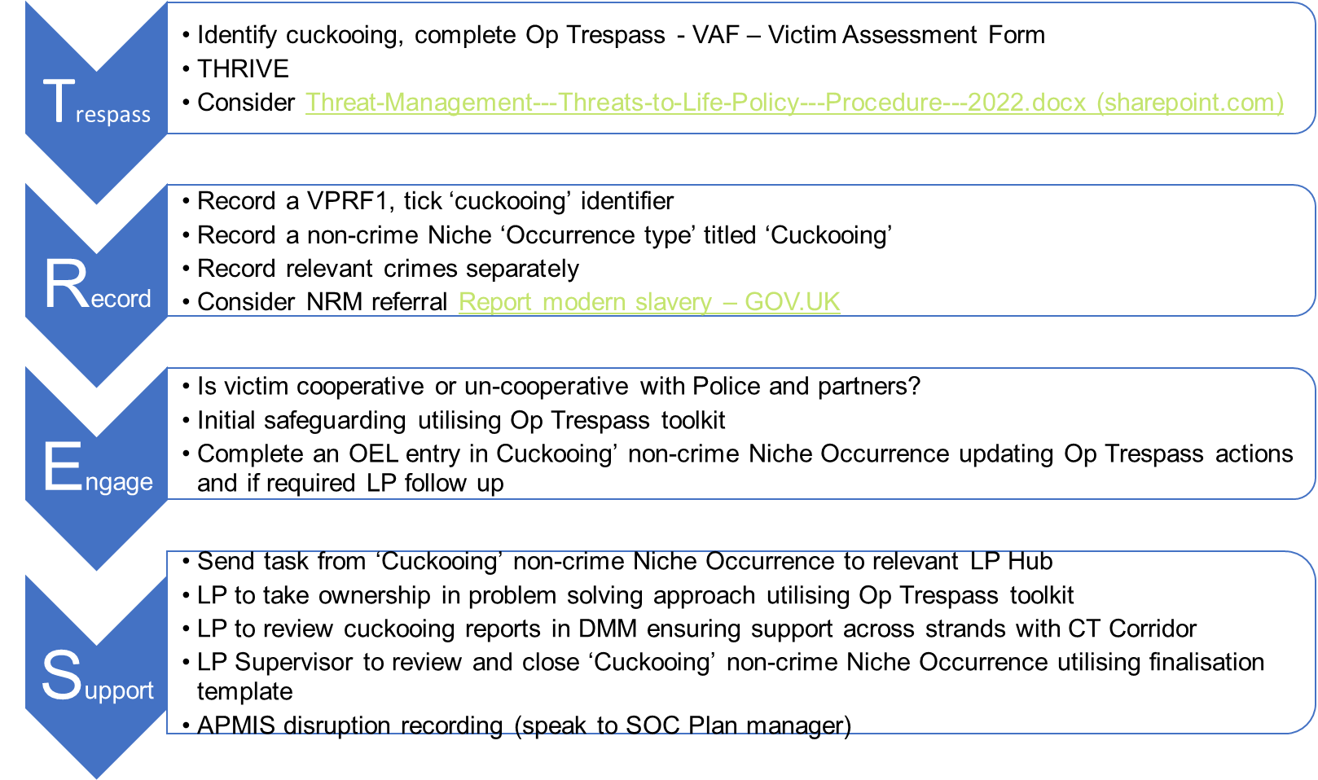
Op Trespass
Notes:
Op Trespass. Essentially, as I’ve already said, there is a current education programme in place to educate staff across the force about cuckooing and to clarify the expectations of officers attending incidents. To support this, there is guidance, a toolkit and additional resources available to officers via the force intranet. These include a grab kit of posters and leaflets amongst other things.
The new process encourages the recording of incidents of cuckooing, considers engagement with and supportive measures for victims.
The process starts with the identification of cuckooing. If identified, officers should complete a Victim Assessment Form. This provides a risk score and supports colleagues to put appropriate management in place based on threat, risk and harm. (Eg, Threat assessment if required).
Officers are also expected to complete a niche non-crime occurrence in addition to any other identified offences. The purpose of this is to provide the force with the ability to search for incidents of cuckooing from a performance management perspective. This will provide a better picture of the prevalence of cuckooing within the force and will allow for a more in-depth analysis of the response to identify best practice.
Also from a recording perspective, the force have introduced a tick box on their vulnerable person referrals forms (which will be called something different in each force, but essentially these are the forms completed to make referrals to social care and other partners). Since that was introduced, the box has been ticked on over 500 occasions and this allows the MASH (multi agency safeguarding hubs) who process the forms to make appropriate referrals to other agencies which may influence outcome.
From an engagement and support perspective, officers are required to update the non-crime occurrence with the action they have taken and then task this to the relevant local policing hub. Local policing take ownership of the occurrence using a problem-solving approach. All incidents of cuckooing are reviewed at the daily management meeting, the local policing supervisor has responsibility for reviewing and closing occurrences utilising a finalisation template.

Slide 5
Some of our training tools
Why Is Sec 45 Causing So Many Problems ?
https://360.articulate.com/review/content/c43ff623-fb87-4355-b5a0-7698bdd9ae7b/review
Notes:
This is a partner training tool that we have developed with Merseyside. We are hoping to be able to share this in a format that allows other agencies / forces to download it and adapt it for their needs – particularly regarding the part about directing to intelligence sharing.

Slide 6
What can you do?
Why Is Sec 45 Causing So Many Problems ?
Think about what policy and practice exists in your workplace to identify vulnerability and exploitation.
Do your staff know what to look for?
Do they know what to do if they have a concern?
Do you have the right recording mechanisms?
Do you need training tools or resources?
Do you need support to develop your policy and practice?
Notes:
We often say and I’ll say it again – This is a complex issue and it requires a multi-agency response to tackle it from all aspects.
No matter what organization you work for, think about what policy and practice exists in your workplace to identify vulnerability and to tackle exploitation.
Do staff know what to look for?
Do they know what to do if they have a concern?
Do they know how to report it?
Do you need training tools or resources to enhance knowledge, understanding and awareness?
Do you need support to develop your policy and practice?
The National County Lines co-ordination Centre can help with this, so please get in touch.

Slide 7
Legislation
Why Is Sec 45 Causing So Many Problems ?
What do you think the gaps are?
What do you think new legislation should provide?

Slide 8
Contact us
Why Is Sec 45 Causing So Many Problems ?
NCLCCMailbox-.Centre@met.police.uk

