Slide 1
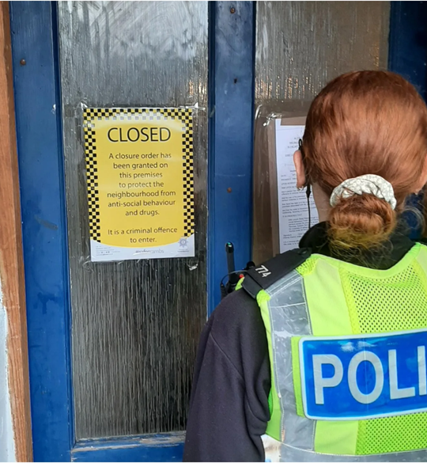
Tackling Cuckooing in Social Housing
31 January 2024

Slide 2
Cuckooing in Social Housing
The Speaker
31 January 2024
Worked in Housing Law since 2010
Represents some of the largest RSLs in the Country
Experience dealing with issues from drug related crime for RSLs including cuckooing, violent crime, drug grows.
Andy Moore
Partner
Head of Anti-Social Behaviour (Social Housing)

Slide 3
Cuckooing in Social Housing
Topics
31 January 2024
Issues faced by Registered Providers
Injunctions under ASBCP Act 2014
Issues in enforcement
Scope for Reform

Slide 4
Cuckooing in Social Housing
Cuckooing in Social Housing
31 January 2024
Why is Social Housing stock impacted?
Deprivation
Social housing has become more concentrated in deprived areas.
Links to Deprivation and Crime
Drugs and weapons offences were recorded 2.3 times more in the most income-deprived 10% of areas compared to the least income-deprived 10%.
Allocation
A person has a priority need if they, or someone they either live with or are reasonable expected to live with, are vulnerable because of old age, a mental health condition, a disabled person or some other special reason.

Slide 5
Cuckooing in Social Housing
Cuckooing in Social Housing
31 January 2024
Who do we see in practice carrying out cuckooing?
Incredibly organised and ruthless criminal networks.
Groups of drug users often with no fixed abode.
Individuals scamming vulnerable people i.e. financial abuse.

Slide 6
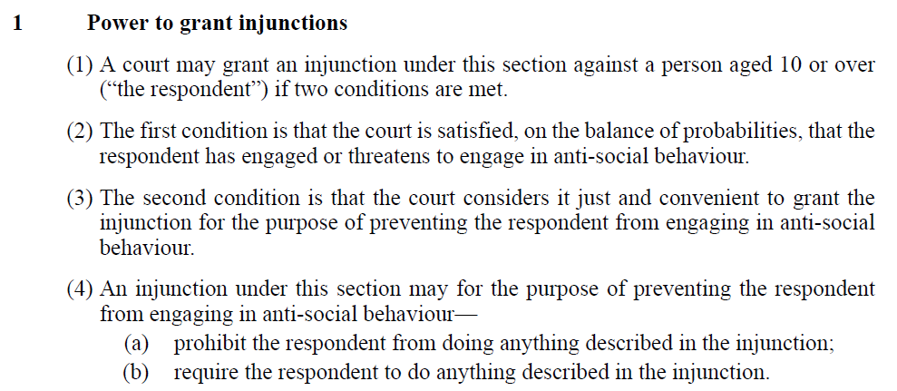
Cuckooing in Social Housing
Injunctions under ASBCP Act 2014
31 January 2024
Statute Focus

Slide 7
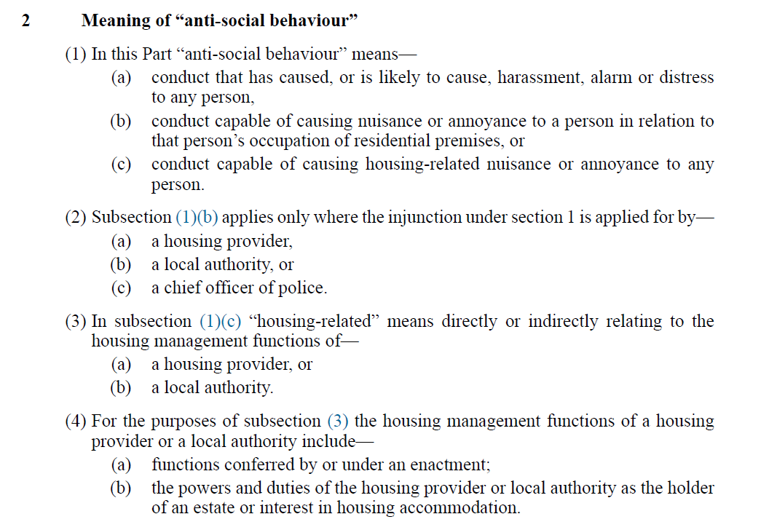
Cuckooing in Social Housing
Injunctions under ASBCP Act 2014
31 January 2024
Statute Focus

Slide 8
Cuckooing in Social Housing
Focus on Offending Flat A
31 January 2024
Background
Flat A was targeted primarily by groups of drug users with no fixed abode.
Who Targeted?
Individual and nuisance caused to neighbours.
Impact
Long standing issues with groups of people. Drug paraphernalia. Noise. Fighting. No money or food for resident.
Remedies Sought
Injunction banning Tenant allowing named individuals. 12 individuals banned from block.
Statute Focus

Slide 9
Cuckooing in Social Housing
Focus on Offending Mr W
31 January 2024
Background
Mr W was of no fixed abode. History of burglary.
Who Targeted?
Targeted individuals in the town centre and befriended them.
Impact
Took over properties. Groups of people. Stolen goods stored. No food.
Remedies Sought
Injunction banning Mr W from the whole area.
Statute Focus

Slide 10
Cuckooing in Social Housing
Focus on Offending Mr N
31 January 2024
Background
Mr N had a property of his own in a relatively affluent area. Drink and DV background.
Who Targeted?
Unusually commuted 10 miles to cause issues. DV victim and neighbours. Local vulnerable family.
Impact
Suspected sexual and violent assault on vulnerable family. Fear for neighbours.
Remedies Sought
Injunction banning Mr N from specific properties and defined area.
Statute Focus

Slide 11
Cuckooing in Social Housing
Issues in Enforcement
31 January 2024
Wookey Capacity
The court should not make an injunction that cannot be enforced.
If D incapable of understanding what he was doing, or that it was wrong, then should not grant injunction.
Even if a D is capable of understanding the nature and requirements of the injunction, if they are unable comply with the terms of the injunction, no injunction should be made.
Evidence
Evidential test switches to criminal standard of proof i.e. “beyond reasonable doubt”.
Vulnerable victims unable / unwilling to come forward.
Generally only able to rely on Police evidence of D in the exclusion area.
Sentencing
Will take multiple breaches to make the injunction have teeth.
Focus
Wookey v Wookey [1991] 3 All ER
Pender v DPP [2013] EWHC 2598 (Admin)

Slide 12
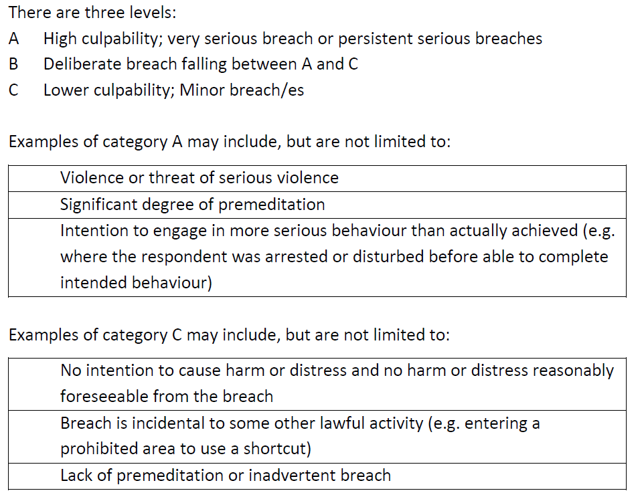
Cuckooing in Social Housing
Sentencing
31 January 2024
Culpability
Focus

Slide 13
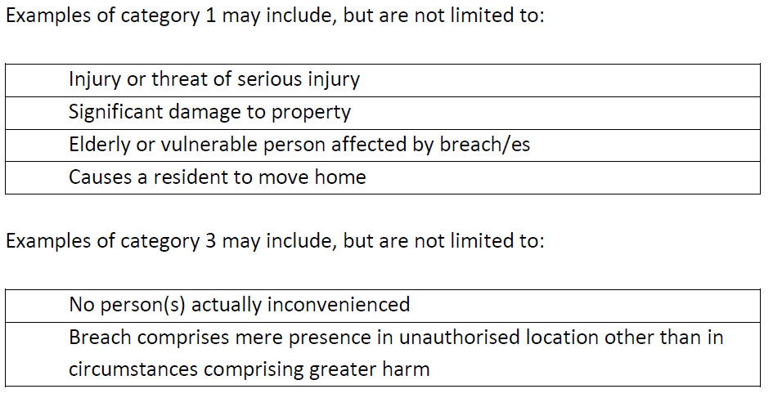
Cuckooing in Social Housing
Sentencing
31 January 2024
Harm
Focus

Slide 14
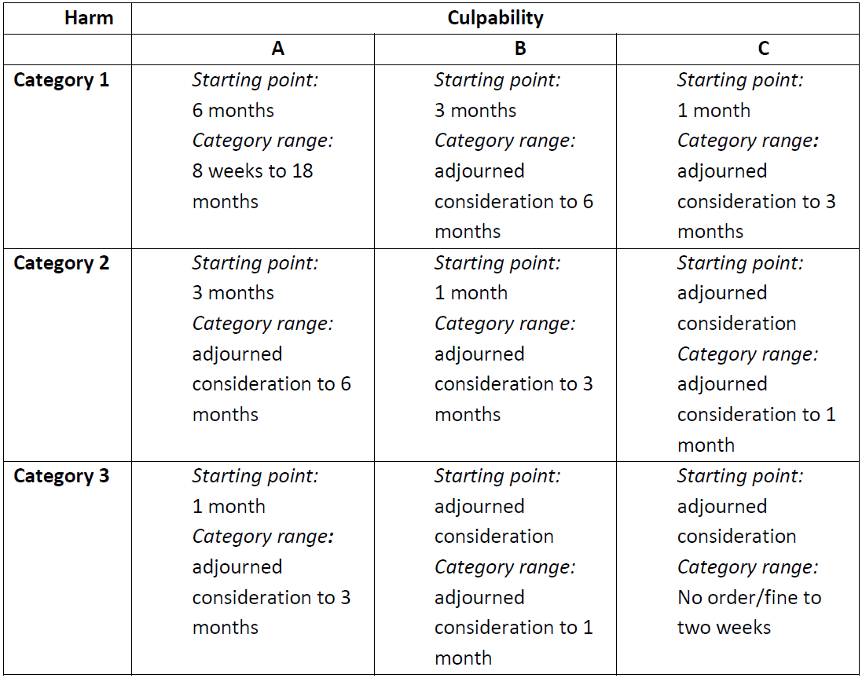
Cuckooing in Social Housing
Sentencing
31 January 2024
Focus

Slide 15
Cuckooing in Social Housing
Scope for Reform?
31 January 2024
ASBCP Act 2014
Scope for cuckooing as a specific finding / offence under the Act – findings would be on balance of probabilities.
Change of the Sentencing Guidelines
Specific higher sentences for cuckooing in the guidelines in the event of a cuckooing finding.
Focus

Slide 16
Cuckooing in Social Housing
Contact Me
31 January 2024
Andy Moore
Partner
Head of Anti-Social Behaviour (Social Housing)
andymoore@msbsolicitors.co.uk

