Slide 1
County lines cuckooing in Lincoln- A risk terrain approach to identifying risk.
Hayley Fox
Professional Doctorate Candidate- Keele University
Crime Intelligence Analyst- Lincolnshire Police

Slide 2
Presentation Overview
Introduction
Introduction to risk terrain modelling?
My background, the origins of the research.
What is risk terrain modelling (RTM)?
Key criminological concepts used in RTM.
RTM as evidence-based practice.
Examples of RTM.

Slide 3
Presentation Overview
Determining risk factors
Modelling the risk factors
Literature review
Comparative analysis of conjunctive cases
Officer interviews
Mapping the locations
Determining the distance
Proximity or density

Slide 4
Presentation Overview
The RTM results
Determining the success of the RTM analysis
Representing the results
Testing the accuracy of the results
Predictive accuracy index scores
Police officer views

Slide 5
Introduction
Over 20 years’ experience as a crime intelligence analyst for Lincolnshire Police.
Currently the thematic analyst for county lines and drugs for the west of the county.
Long standing interest in crime mapping techniques.
Currently a Professional Doctorate candidate at Keele University.
Hayley.Fox@Lincs.police.uk

Slide 6
Introduction to Risk Terrain Modelling (RTM)
‘Risk values in an RTM do not suggest the inevitability of crime. Instead, they point to locations where, if the conditions are right, the risk of illegal behavior will be high.’ (Caplan et al. 2015)
‘Essentially, RTM is an analytical tool that allows for the creation of an intuitive and detailed analysis of the underlying risk factors present in a landscape, assisting in our understanding of why crime is occurring in specific locales.’ (Drawve, Thomas & Walker 2016)

Slide 7
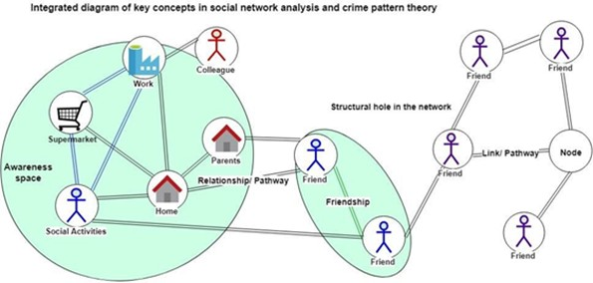
Key criminological concepts used in RTM
‘RTM draws on concepts derived from environmental criminological perspectives, prior literature, and a familiarity with an area to forecast crime in reference to the environmental backcloth (Brantingham & Brantingham, 1995).’
(Drawve, Thomas & Walker 2016)
Risky facilities and the 80-20 rule (Clarke & Eck 2007)
Theory of risky places (Caplan & Kennedy 2013)
Routine activity theory (Cohen & Felson 1979)
Environmental backcloth (Brantingham & Brantingham 1981)
Crime pattern theory, crime generators and attractors (Brantingham & Brantingham 1993)

Slide 8
Why use RTM?
‘RTM diagnoses the underlying spatial factors that create risk at high-crime places. Police interventions are then designed to suppress crime in the short term and mitigate spatial risk factors at these areas to make them less attractive to criminals in the long term’ (Caplan, Kennedy, and Piza 2014).
Systematic review by Marchment & Gill (2021):
25 studies, 12 crime types
RTM successful in identifying at risk places for acquisitive crimes, violent crimes, child maltreatment, terrorism, drug related crimes and driving whilst intoxicated.

Slide 9
Examples of RTM
Place based correlates of Motor Vehicle Theft and Recovery (Piza, Feng, Kennedy & Caplan 2017)
Vehicle collisions (Drawve, Grubb, Steinman & Belongie 2019)
Road safety (Sieveneck & Sutter 2021)
Illicit drug markets in Bogota, Columbia (Escudero & Ramirez 2018)
Violence (Gerrell 2018), (Gimenez-Santana, Caplan & Drawve 2018)
Burglary (Moreto 2010), (Caplan, Kennedy, Barnum & Piza 2015)
Homeless related crime (Yoo & Wheeler 2019)
Burglary and theft from vehicles (Vildosola, Carter, Louderback & Roy 2020)
Marijuana Cultivation sites (Richardson 2019)

Slide 10
Determining risk factors
Officer opinions
Bail hostels
Coastal towns, holiday makers needing to buy
Flats
Homeless accommodation
Homes of drug users
Home of vulnerable persons
Local authority housing, housing association housing
Proximity to the railway station
Repeat victims
Specific individuals
Supported accommodation
Towns with a sufficient population
Vulnerable youths
Youth hostels, children’s homes
Comparative analysis of conjunctive cases
Officer interviews
Comparative analysis of conjunctive cases
Population >15,000
Population >15,000 and railway station
Population >15,000 and railway station and needle exchange
Population >15,000 and railway station and homeless hostel
Population >15,000 and railway station and homeless hostel and market town/coastal
Population >15,000 and railway station and homeless hostel and market town/coastal and drug rehabilitation

Slide 11
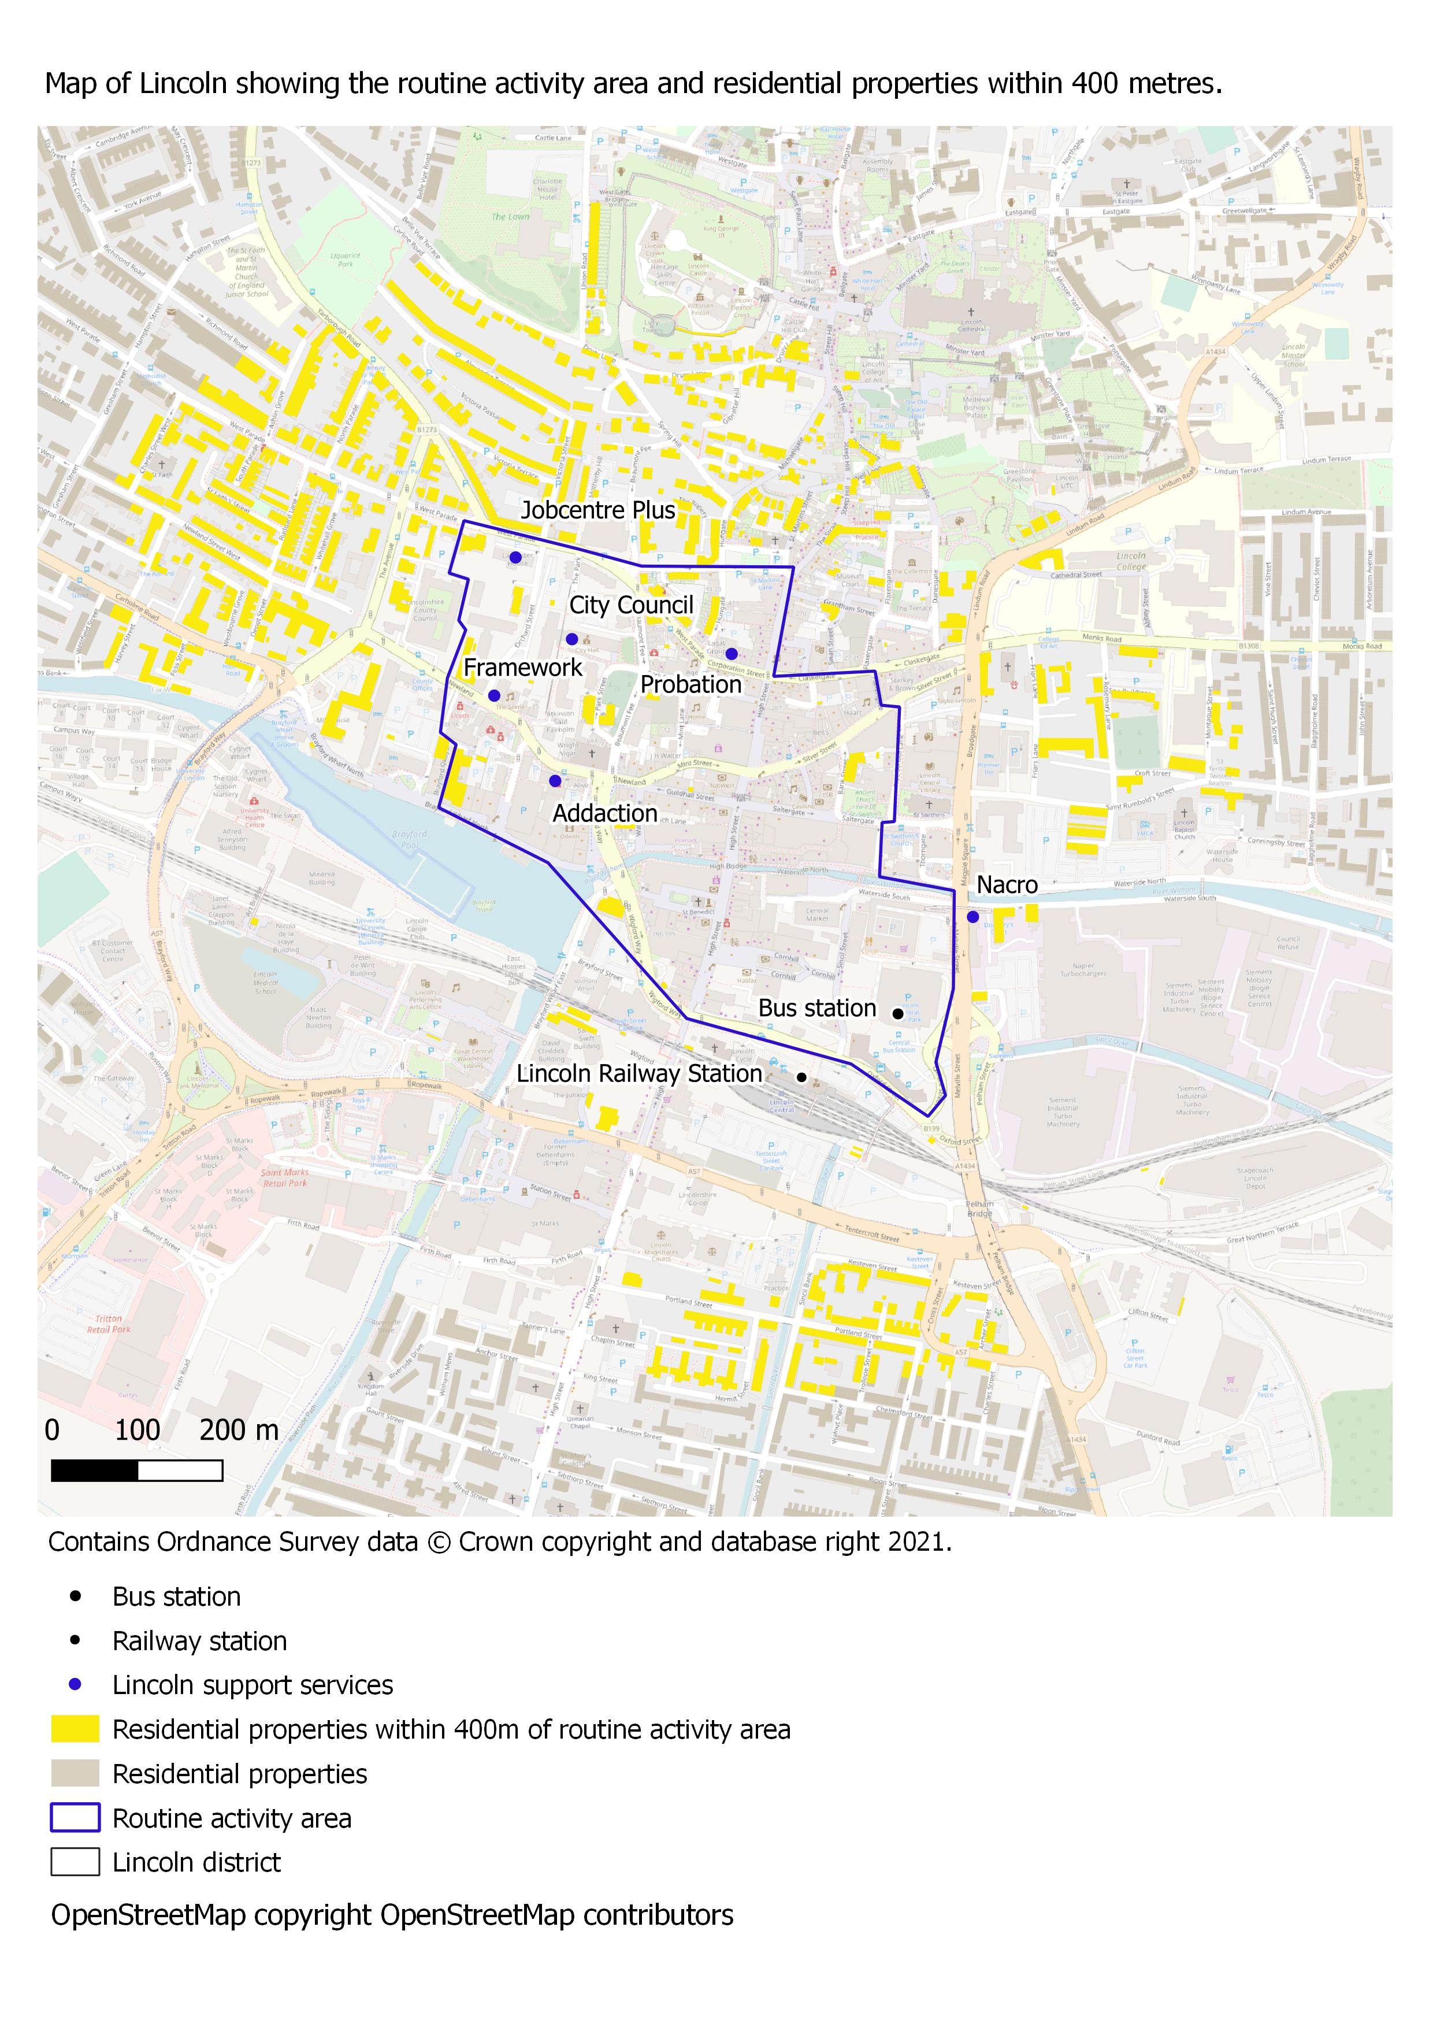
Modelling the risk factors
Mapping the locations
Determining the distance
Proximity or density

Slide 12
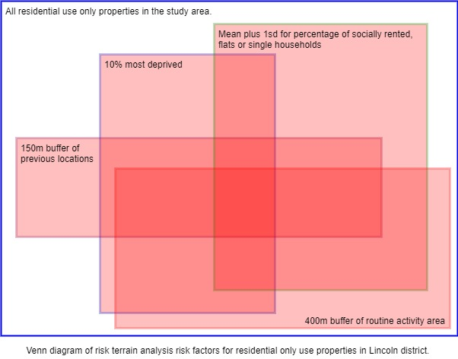
Modelling the risk factors
Certain factors increase the risk of crime at locations.
Where these risk factors overlap risk will increase.
This risk will be the highest where there has been previous exposure to crime.

Slide 13
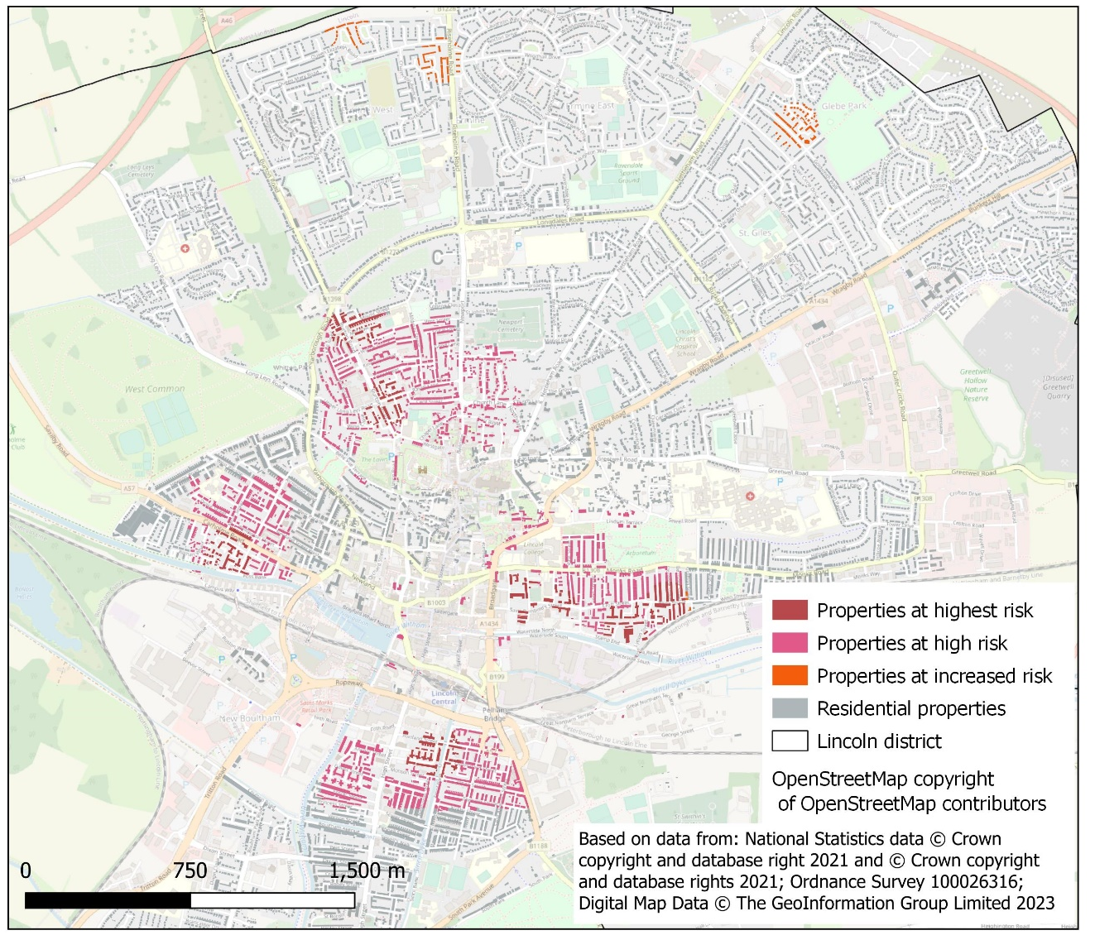
Results
Previous exposure

Slide 14
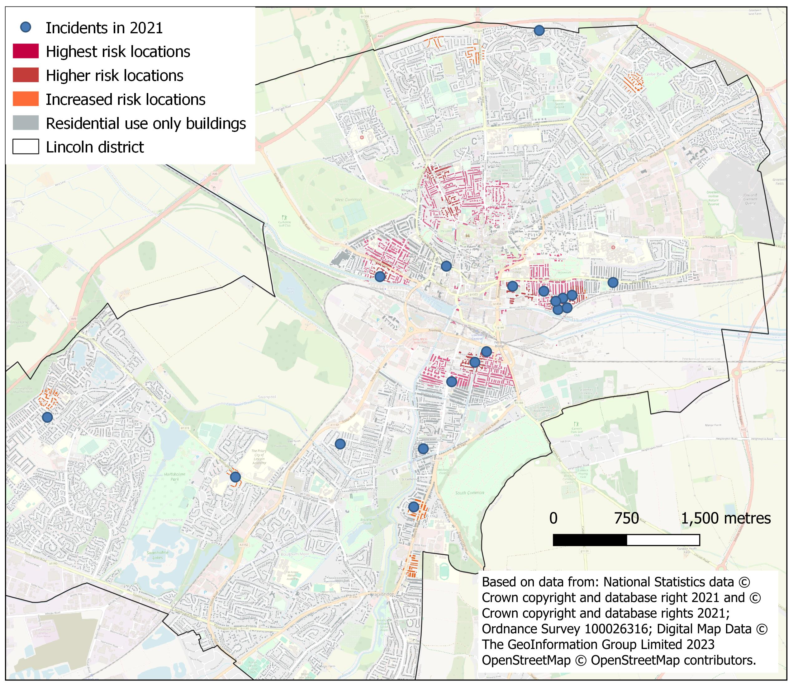
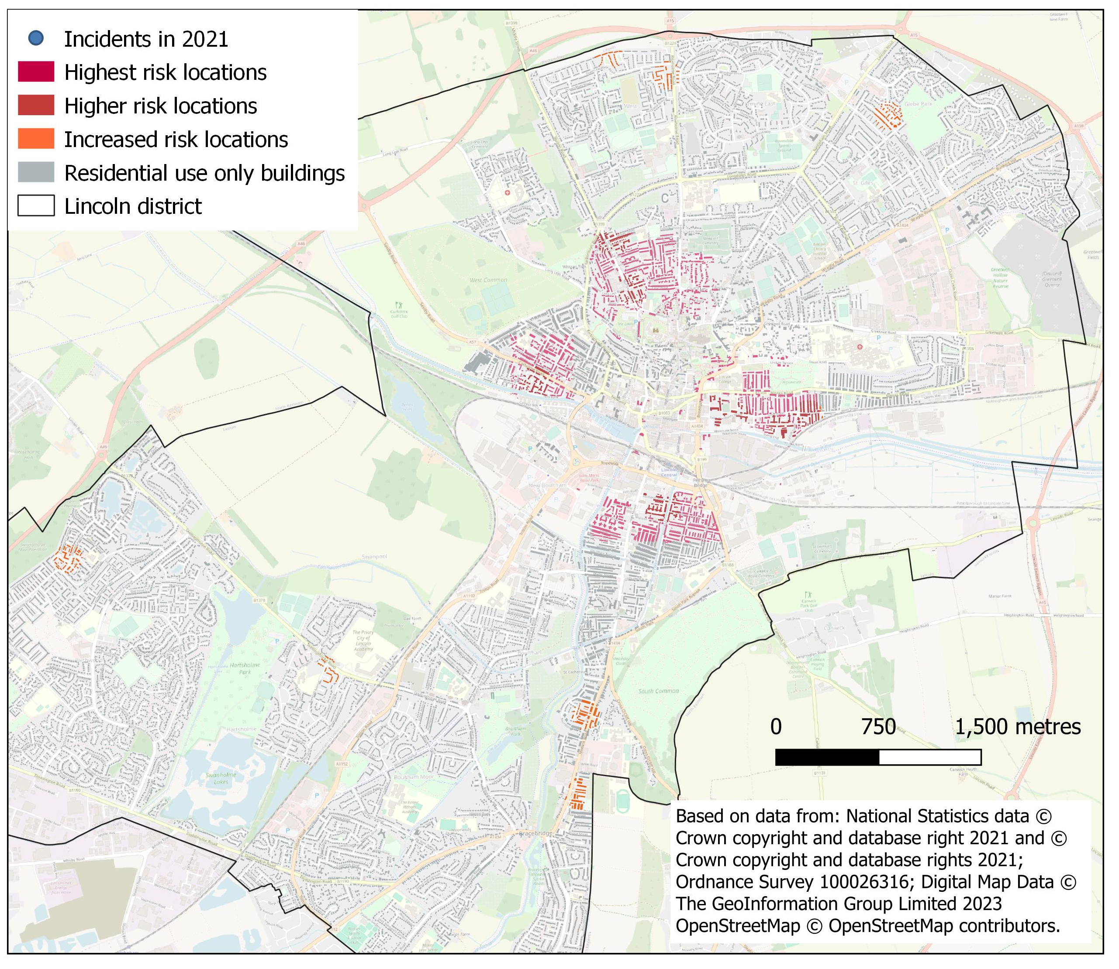
Results

Slide 15
RTMdx Software Results

Slide 16
Determining the success of RTM
Predictive Accuracy Index, (PAI) (Chainey et al., 2008)
PAI=Hit Rate / Percentage area
hit rate is the number of events in the high-risk area/ total events in the district * 100,
and percentage area is the area of high risk / total area of the district * 100.

Slide 17
Determining the success of RTM
RTMdx model with place size of 150m.
Including 100m exposure layer
PAI
17.8
Risk factor identified:
Proximity to output areas containing constrained city dwellers
Proximity to Probation Service
Influence:
Within 300m
Within 1200m
RRV 23.03
RRV 7.43
Area
12%
PAI
4.9
Victims
58%

Slide 18
Determining the success of RTM
But you know, being able to put in context, it’s not just why is it happening there, it’s why is it not happening here? (Ch. Insp)
Police officer views:
So I think in terms of hot spot patrolling, erm this is far better (Insp)
Do we know why that's not flagged up any risk? (Insp)
Having, you know, drawn on a map myself, something very similar, so, to me, the better information is the why. (Insp)
I mean to me, the you know the gold-plated thing that we could do with this would be to go to the local authority and go, what you gonna do about this? (Insp)
And it's so difficult to measure if you've had any impact. So if you've got something that you can have an impact on, that's measurable, then that's a massive. (Insp)
I think that's quite an accurate picture from experience (Pc)
I guess you could apply this kind of system to knife crime as well (Insp)

Slide 19
Summary
A method of identifying areas at risk to future criminological events.
Identifies significant locational factors which contribute to that risk.
Combining the significant risk areas with previous exposure areas increases the PAI scores.
The identification of high-risk areas are not influenced by police activity.
The RRV of contributing factors can be used to ascertain if a planned intervention has had an effect.
Can be produced manually or with the Simsi RTMdx software.

Slide 20
Any questions?

Slide 21
Thank you.
Hayley.Fox@lincs.police.uk
Fox, H.Y., 2022. New approaches to understanding County Lines: A risk terrain analysis of cuckooing in Lincoln. British Society of Criminology Newsletter, p.11.
Further information on RTM and the Simsi RTMdx software:
https://www.riskterrainmodeling.com
andy@simsi.com

